Slide 1
ARTIFICIAL NEURAL NETWORKS: AN INTRODUCTION

Slide 2
NEURAL NETWORKS
NN model human brain
ANN tasks – pattern-matching, classification, optimization function, approximation, vector quantization, data clustering
ANN is an efficient processing system which resembles in characteristics with biological neural network.

Slide 3
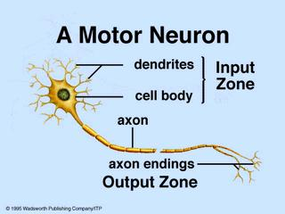
BIOLOGICAL (MOTOR) NEURON

Slide 4
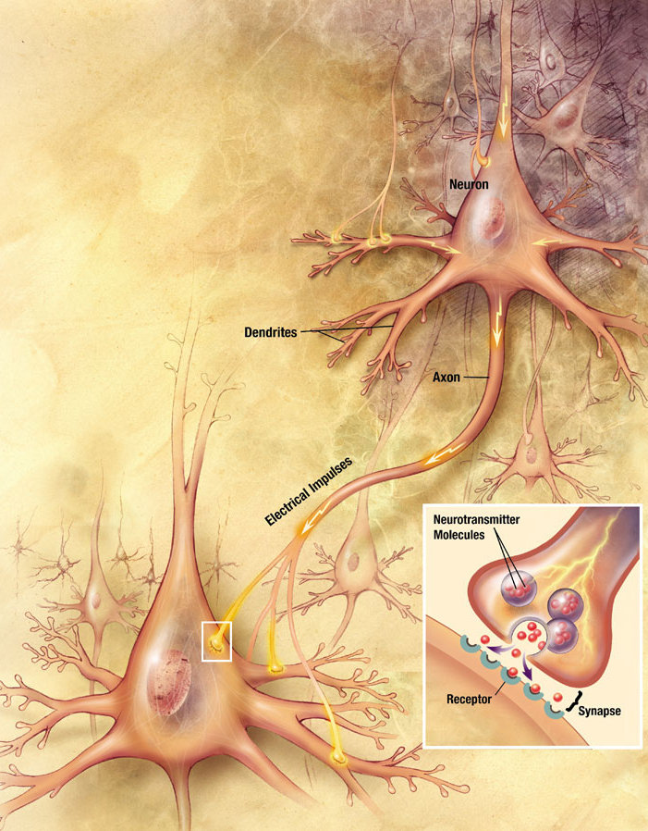

Slide 5
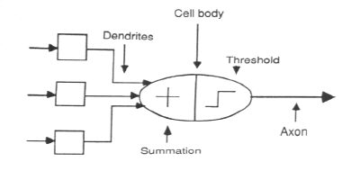
ASSOCIATION OF BIOLOGICAL NET
WITH ARTIFICIAL NET
Neuron
Weights
Output

Slide 6
ARTIFICIAL NEURAL NET
Information-processing system.
Neurons process the information.
The signals are transmitted by means of connection links.
The links possess an associated weight.
The output signal is obtained by applying activations to the net input.

Slide 7
ARTIFICIAL NEURAL NET
W₁
X₁
Y
W₂
X₂
The figure shows a simple artificial neural net with two input neurons (X₁, X₂) and one output neuron (Y). The inter connected weights are given by W₁ and W₂.

Slide 8
PROCESSING OF AN ARTIFICIAL NET
The neuron is the basic information processing unit of a NN. It consists of:
1. A set of links, describing the neuron inputs, with weights W₁, W₂, …, W_{m}.
2. An adder function (linear combiner) for computing the weighted sum of the inputs (real numbers):
3. Activation function for limiting the amplitude of the neuron output.

Slide 9
BIAS OF AN ARTIFICIAL NEURON
The bias value is added to the weighted sum ∑w_{i}x_{i} so that we can transform it from the origin.
Y_{in} = ∑w_{i}x_{i} + b, where b is the bias
x₁-x₂= -1
x₂
x₁-x₂=0
x₁-x₂= 1
x₁

Slide 10
MULTI LAYER ARTIFICIAL NEURAL NET
INPUT: records without class attribute with normalized attributes values.
INPUT VECTOR: X = { x₁, x₂, …, x_{n}} where n is the number of (non-class) attributes.
INPUT LAYER: there are as many nodes as non-class attributes, i.e. as the length of the input vector.
HIDDEN LAYER: the number of nodes in the hidden layer and the number of hidden layers depends on implementation.

Slide 11
OPERATION OF A NEURAL NET
-
Bias
x₀
w_{0j}
x₁
w_{1j}
∑
f
Output y
x_{n}
w_{nj}
Input
vector x
Weight
vector w
Weighted
sum
Activation
function

Slide 12
WEIGHT AND BIAS UPDATION
Per Sample Updating
updating weights and biases after the presentation of each sample.
Per Training Set Updating (Epoch or Iteration)
weight and bias increments could be accumulated in variables and the weights and biases updated after all the samples of the training set have been presented.

Slide 13
STOPPING CONDITION
All change in weights (Δwij) in the previous epoch are below some threshold, or
The percentage of samples misclassified in the previous epoch is below some threshold, or
A pre-specified number of epochs has expired.
In practice, several hundreds of thousands of epochs may be required before the weights will converge.

Slide 14
BUILDING BLOCKS OF ARTIFICIAL NEURAL NET
Network Architecture (Connection between Neurons)
Setting the Weights (Training)
Activation Function

Slide 15
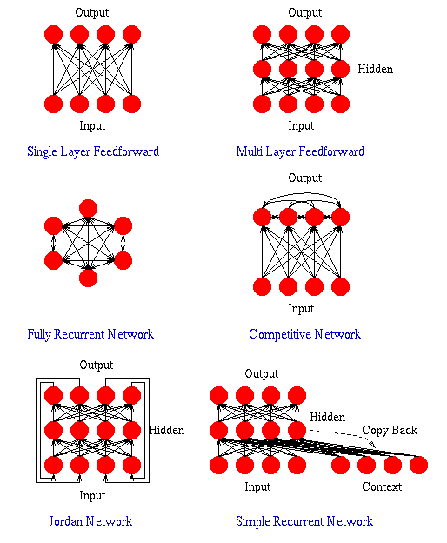

Slide 16
LAYER PROPERTIES
Input Layer: Each input unit may be designated by an attribute value possessed by the instance.
Hidden Layer: Not directly observable, provides nonlinearities for the network.
Output Layer: Encodes possible values.

Slide 17
TRAINING PROCESS
Supervised Training - Providing the network with a series of sample inputs and comparing the output with the expected responses.
Neural Network
X
(Input)
Y
(Actual Output)
Error Signals
(D-Y)
Error Signal Generator
D
(Desired Output)

Slide 18
TRAINING PROCESS
Unsupervised Training - Most similar input vector is assigned to the same output unit.
Reinforcement Training - Right answer is not provided but indication of whether ‘right’ or ‘wrong’ is provided.
X
(Input)
Neural Network
Y
(Actual Output)
Neural Network
X
(Input)
Y
(Actual Output)
Error Signals
Error Signal Generator
R
(Reinforcement Signals)
Notes:
Example of RL:
Game playing - determining the best move to make in a game often depends on a number of different factors, hence the number of possible states that can exist in a particular game is usually very large. To cover this many states using a standard rule based approach would mean specifying an also large number of hard coded rules. RL cuts out the need to manually specify rules, agents learn simply by playing the game. For two player games such as backgammon, agents can be trained by playing against other human players or even other RL agents.Control problems - such as elevator scheduling. Again, it is not obvious what strategies would provide the best, most timely elevator service. For control problems such as this, RL agents can be left to learn in a simulated environment and eventually they will come up with good controlling policies. Some advantages of using RL for control problems is that an agent can be retrained easily to adapt to environment changes, and trained continuously while the system is online, improving performance all the time.

Slide 19
ACTIVATION FUNCTION
ACTIVATION LEVEL – DISCRETE OR CONTINUOUS
HARD LIMIT FUCNTION (DISCRETE)
Binary Activation function
Bipolar activation function
Identity function
SIGMOIDAL ACTIVATION FUNCTION (CONTINUOUS)
Binary Sigmoidal activation function
Bipolar Sigmoidal activation function

Slide 20
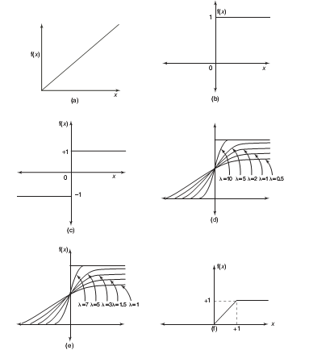
ACTIVATION FUNCTION
Activation functions:
(A) Identity
(B) Binary step
(C) Bipolar step
(D) Binary sigmoidal
(E) Bipolar sigmoidal
(F) Ramp

Slide 21
CONSTRUCTING ANN
Determine the network properties:
Network topology
Types of connectivity
Order of connections
Weight range
Determine the node properties:
Activation range
Determine the system dynamics
Weight initialization scheme
Activation – calculating formula
Learning rule

Slide 22
PROBLEM SOLVING
Select a suitable NN model based on the nature of the problem.
Construct a NN according to the characteristics of the application domain.
Train the neural network with the learning procedure of the selected model.
Use the trained network for making inference or solving problems.

Slide 23
NEURAL NETWORKS
Neural Network learns by adjusting the weights so as to be able to correctly classify the training data and hence, after testing phase, to classify unknown data.
Neural Network needs long time for training.
Neural Network has a high tolerance to noisy and incomplete data.

Slide 24
SALIENT FEATURES OF ANN
Adaptive learning
Self-organization
Real-time operation
Fault tolerance via redundant information coding
Massive parallelism
Learning and generalizing ability
Distributed representation

Slide 25
McCULLOCH–PITTS NEURON
Neurons are sparsely and randomly connected
Firing state is binary (1 = firing, 0 = not firing)
All but one neuron are excitatory (tend to increase voltage of other cells)
One inhibitory neuron connects to all other neurons
It functions to regulate network activity (prevent too many firings)

Slide 26
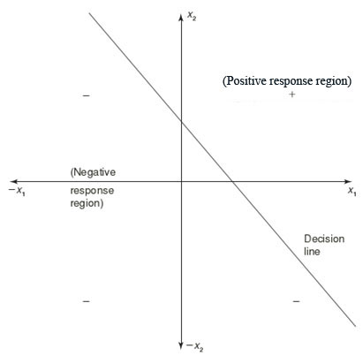
LINEAR SEPARABILITY
Linear separability is the concept wherein the separation of the input space into regions is based on whether the network response is positive or negative.
Consider a network having positive response in the first quadrant and negative response in all other quadrants (AND function) with either binary or bipolar data, then the decision line is drawn separating the positive response region from the negative response region.

Slide 27

FEW APPLICATIONS OF NEURAL NETWORKS

